Slide 1
设计与建造Ⅱ·可展机构
课程报告二
设计与建造二班五组
刘宇轩 张佳瑜 罗松寒
冒惠敏 郭伟祺 白 韬

Slide 2
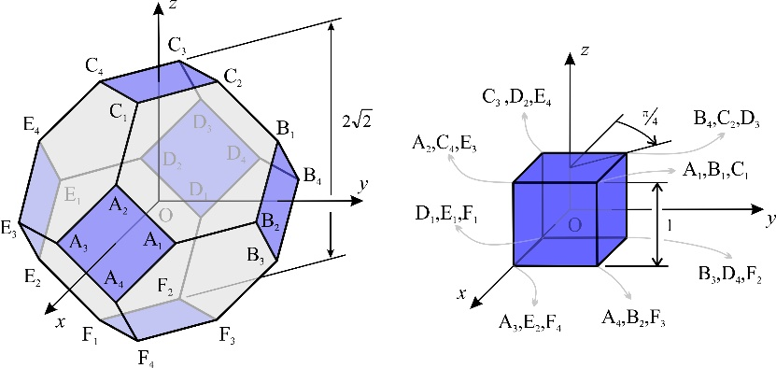
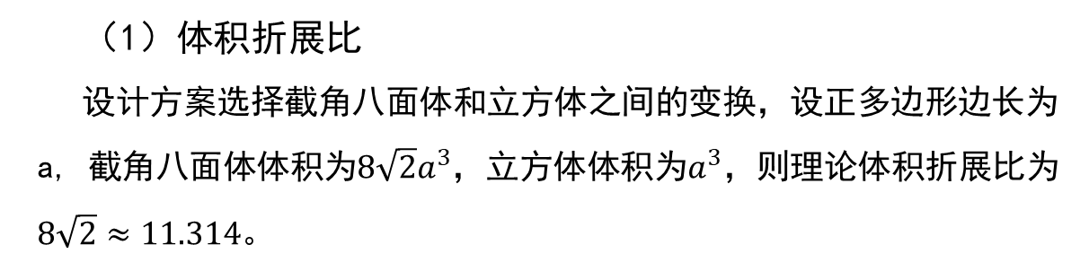
可展结构——设计计算
（1）体积折展比 设计方案选择截角八面体和立方体之间的变换，设正多边形边长为a, 截角八面体体积为$8\sqrt{2}a^{3}$，立方体体积为$a^{3}$，则理论体积折展比为$8\sqrt{2}≈11.314$。

Slide 3
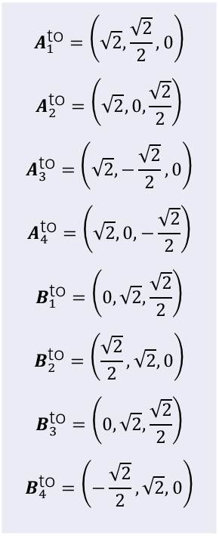
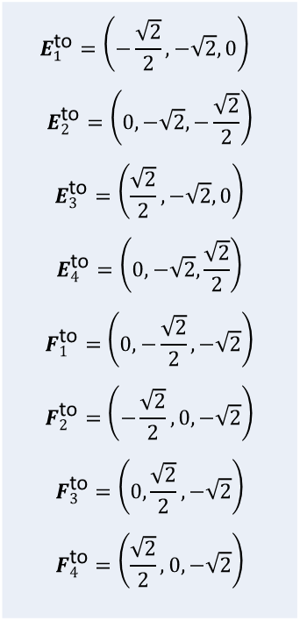
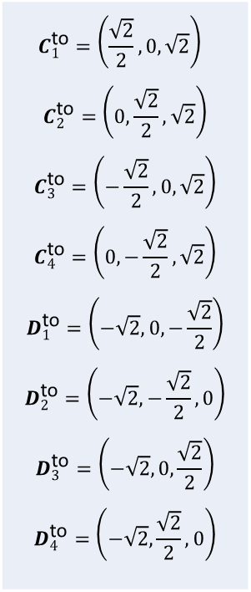
可展结构——设计计算
（2）运动副空间坐标
$$A_{1}^{\text{to}}=\left(\sqrt{2},\frac{\sqrt{2}}{2},0\right)$$ $$A_{2}^{\text{to}}=\left(\sqrt{2},0,\frac{\sqrt{2}}{2}\right)$$ $$A_{3}^{\text{to}}=\left(\sqrt{2},−\frac{\sqrt{2}}{2},0\right)$$ $$A_{4}^{\text{to}}=\left(\sqrt{2},0,−\frac{\sqrt{2}}{2}\right)$$ $$B_{1}^{\text{to}}=\left(0,\sqrt{2},\frac{\sqrt{2}}{2}\right)$$ $$B_{2}^{\text{to}}=\left(\frac{\sqrt{2}}{2},\sqrt{2},0\right)$$ $$B_{3}^{\text{to}}=\left(0,\sqrt{2},\frac{\sqrt{2}}{2}\right)$$ $$B_{4}^{\text{to}}=\left(−\frac{\sqrt{2}}{2},\sqrt{2},0\right)$$
$$C_{1}^{\text{to}}=\left(\frac{\sqrt{2}}{2},0,\sqrt{2}\right)$$ $$C_{2}^{\text{to}}=\left(0,\frac{\sqrt{2}}{2},\sqrt{2}\right)$$ $$C_{3}^{\text{to}}=\left(−\frac{\sqrt{2}}{2},0,\sqrt{2}\right)$$ $$C_{4}^{\text{to}}=\left(0,−\frac{\sqrt{2}}{2},\sqrt{2}\right)$$ $$D_{1}^{\text{to}}=\left(−\sqrt{2},0,−\frac{\sqrt{2}}{2}\right)$$ $$D_{2}^{\text{to}}=\left(−\sqrt{2},−\frac{\sqrt{2}}{2},0\right)$$ $$D_{3}^{\text{to}}=\left(−\sqrt{2},0,\frac{\sqrt{2}}{2}\right)$$ $$D_{4}^{\text{to}}=\left(−\sqrt{2},\frac{\sqrt{2}}{2},0\right)$$
$$E_{1}^{\text{to}}=\left(−\frac{\sqrt{2}}{2},−\sqrt{2},0\right)$$ $$E_{2}^{\text{to}}=\left(0,−\sqrt{2},−\frac{\sqrt{2}}{2}\right)$$ $$E_{3}^{\text{to}}=\left(\frac{\sqrt{2}}{2},−\sqrt{2},0\right)$$ $$E_{4}^{\text{to}}=\left(0,−\sqrt{2},\frac{\sqrt{2}}{2}\right)$$ $$F_{1}^{\text{to}}=\left(0,−\frac{\sqrt{2}}{2},−\sqrt{2}\right)$$ $$F_{2}^{\text{to}}=\left(−\frac{\sqrt{2}}{2},0,−\sqrt{2}\right)$$ $$F_{3}^{\text{to}}=\left(0,\frac{\sqrt{2}}{2},−\sqrt{2}\right)$$ $$F_{4}^{\text{to}}=\left(\frac{\sqrt{2}}{2},0,−\sqrt{2}\right)$$
当多面体的每边都有单位长度时，截角八面体所有24个顶点坐标如左式所示。（其中上角标“to”表示截角八面体—truncated octahedron）

Slide 4
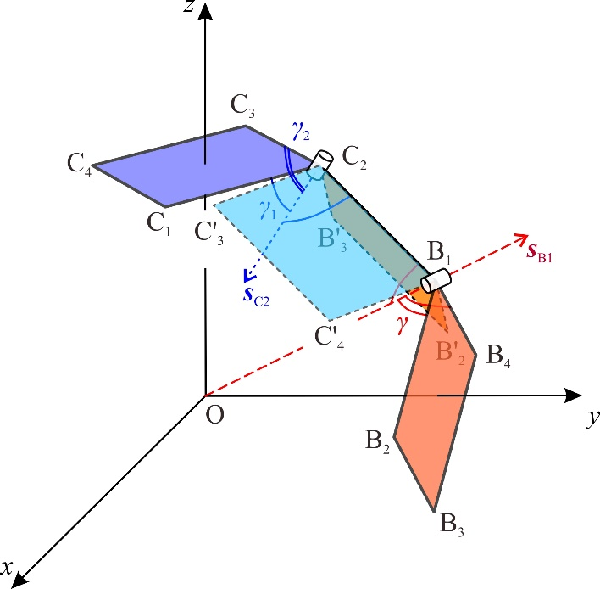

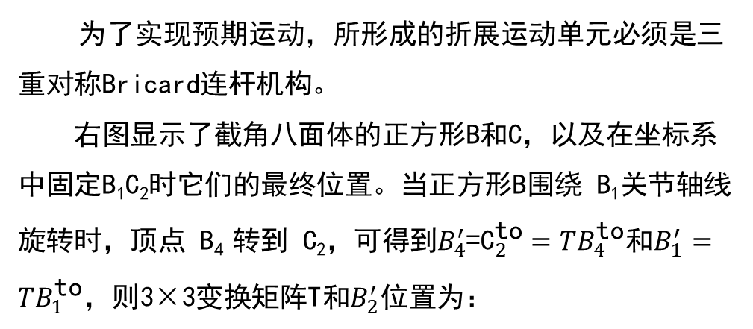
可展结构——设计计算
（3）Bricard机构配置
为了实现预期运动，所形成的折展运动单元必须是三重对称Bricard连杆机构。
右图显示了截角八面体的正方形B和C，以及在坐标系中固定B₁C₂时它们的最终位置。当正方形B围绕 B₁关节轴线旋转时，顶点 B₄ 转到 C₂，可得到$B_{4}^{′}\text{=}{\text{C}}_{2}^{\text{to}}=TB_{4}^{\text{to}}$和$B_{1}^{′}=TB_{1}^{\text{to}}$，则3×3变换矩阵T和$B_{2}^{′}$位置为：
$$T=\left[\begin{matrix}−\frac{2}{3} & −\frac{1}{3} & \frac{2}{3} \\ \frac{1}{3} & \frac{2}{3} & \frac{2}{3} \\ −\frac{2}{3} & \frac{2}{3} & −\frac{1}{3}\end{matrix}\right]$$
$B_{2}^{′}=TB_{2}^{\text{to}}$=$\left(−\frac{2}{3}\sqrt{2},\frac{5}{6}\sqrt{2},\frac{1}{3}\sqrt{2}\right)$

Slide 5
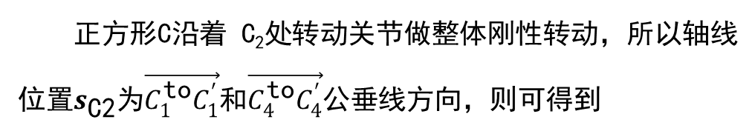

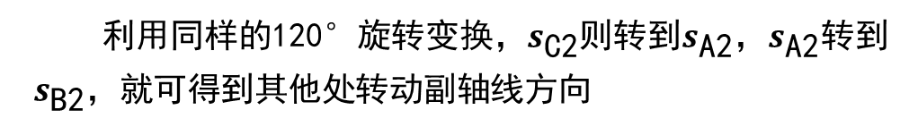
可展结构——设计计算
（3）Bricard机构配置
正方形B和C形成立方体的两个垂直面，有
则$C_{4}^{′}$的最终位置为
$$C_{4}^{′}=\left(\frac{1}{3},−\frac{2}{3}+\sqrt{2},\frac{\sqrt{2}}{2}−\frac{2}{3}\right)$$
正方形C沿着 C₂处转动关节做整体刚性转动，所以轴线位置$s_{\text{C}\text{2}}$为$\vec{C_{1}^{\text{to}}C_{1}^{′}}$和$\vec{C_{4}^{\text{to}}C_{4}^{′}}$公垂线方向，则可得到
利用同样的120°旋转变换，$s_{\text{C}\text{2}}$则转到$s_{\text{A}\text{2}}$，$s_{\text{A}\text{2}}$转到$s_{\text{B}\text{2}}$，就可得到其他处转动副轴线方向

Slide 6
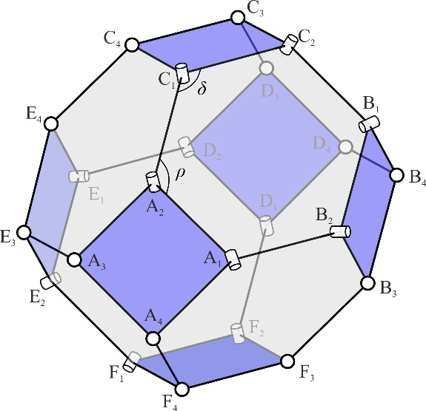
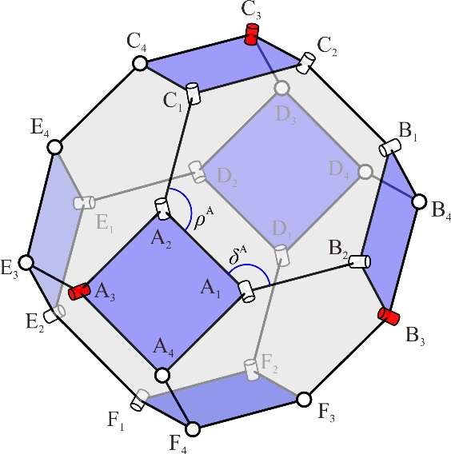
可展结构——设计计算
（4）双自由度消除为单自由度
利用对称性，将A₃ , B₃ 和C₃处的球副替换转动副，可得到单自由度系统。
DoF=1
减少3球副

Slide 7
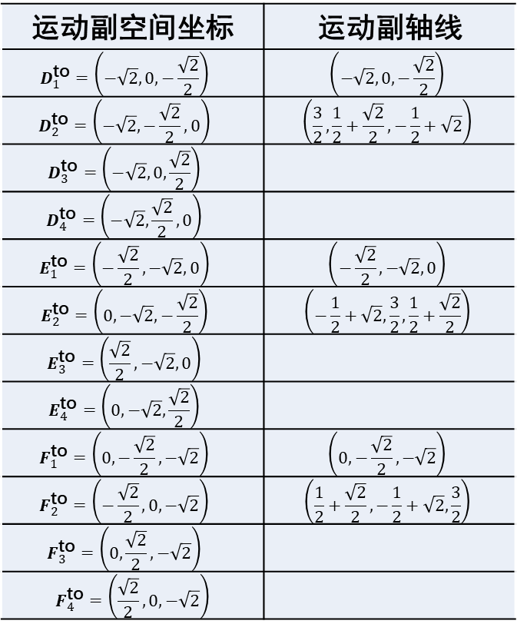
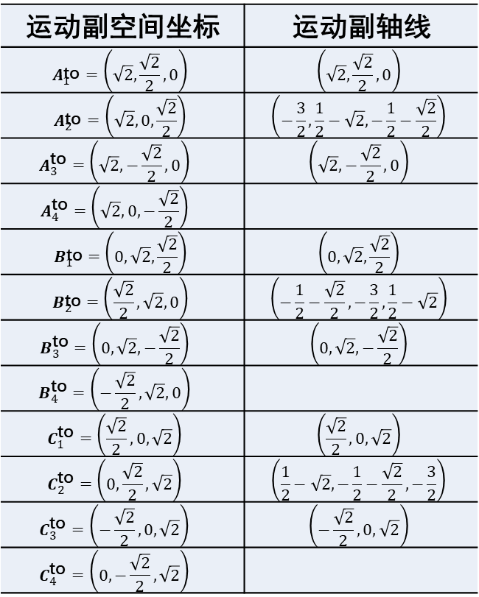
可展结构——设计计算
（5）结果
运动副空间坐标 | 运动副轴线
$$A_{1}^{\text{to}}=\left(\sqrt{2},\frac{\sqrt{2}}{2},0\right)$$ | $$\left(\sqrt{2},\frac{\sqrt{2}}{2},0\right)$$
$$A_{2}^{\text{to}}=\left(\sqrt{2},0,\frac{\sqrt{2}}{2}\right)$$ | $$\left(−\frac{3}{2},\frac{1}{2}−\sqrt{2},−\frac{1}{2}−\frac{\sqrt{2}}{2}\right)$$
$$A_{3}^{\text{to}}=\left(\sqrt{2},−\frac{\sqrt{2}}{2},0\right)$$ | $$\left(\sqrt{2},−\frac{\sqrt{2}}{2},0\right)$$
$$A_{4}^{\text{to}}=\left(\sqrt{2},0,−\frac{\sqrt{2}}{2}\right)$$
$$B_{1}^{\text{to}}=\left(0,\sqrt{2},\frac{\sqrt{2}}{2}\right)$$ | $$\left(0,\sqrt{2},\frac{\sqrt{2}}{2}\right)$$
$$B_{2}^{\text{to}}=\left(\frac{\sqrt{2}}{2},\sqrt{2},0\right)$$ | $$\left(−\frac{1}{2}−\frac{\sqrt{2}}{2},−\frac{3}{2},\frac{1}{2}−\sqrt{2}\right)$$
$$B_{3}^{\text{to}}=\left(0,\sqrt{2},−\frac{\sqrt{2}}{2}\right)$$ | $$\left(0,\sqrt{2},−\frac{\sqrt{2}}{2}\right)$$
$$B_{4}^{\text{to}}=\left(−\frac{\sqrt{2}}{2},\sqrt{2},0\right)$$
$$C_{1}^{\text{to}}=\left(\frac{\sqrt{2}}{2},0,\sqrt{2}\right)$$ | $$\left(\frac{\sqrt{2}}{2},0,\sqrt{2}\right)$$
$$C_{2}^{\text{to}}=\left(0,\frac{\sqrt{2}}{2},\sqrt{2}\right)$$ | $$\left(\frac{1}{2}−\sqrt{2},−\frac{1}{2}−\frac{\sqrt{2}}{2},−\frac{3}{2}\right)$$
$$C_{3}^{\text{to}}=\left(−\frac{\sqrt{2}}{2},0,\sqrt{2}\right)$$ | $$\left(−\frac{\sqrt{2}}{2},0,\sqrt{2}\right)$$
$$C_{4}^{\text{to}}=\left(0,−\frac{\sqrt{2}}{2},\sqrt{2}\right)$$
运动副空间坐标 | 运动副轴线
$$D_{1}^{\text{to}}=\left(−\sqrt{2},0,−\frac{\sqrt{2}}{2}\right)$$ | $$\left(−\sqrt{2},0,−\frac{\sqrt{2}}{2}\right)$$
$$D_{2}^{\text{to}}=\left(−\sqrt{2},−\frac{\sqrt{2}}{2},0\right)$$ | $$\left(\frac{3}{2},\frac{1}{2}+\frac{\sqrt{2}}{2},−\frac{1}{2}+\sqrt{2}\right)$$
$$D_{3}^{\text{to}}=\left(−\sqrt{2},0,\frac{\sqrt{2}}{2}\right)$$
$$D_{4}^{\text{to}}=\left(−\sqrt{2},\frac{\sqrt{2}}{2},0\right)$$
$$E_{1}^{\text{to}}=\left(−\frac{\sqrt{2}}{2},−\sqrt{2},0\right)$$ | $$\left(−\frac{\sqrt{2}}{2},−\sqrt{2},0\right)$$
$$E_{2}^{\text{to}}=\left(0,−\sqrt{2},−\frac{\sqrt{2}}{2}\right)$$ | $$\left(−\frac{1}{2}+\sqrt{2},\frac{3}{2},\frac{1}{2}+\frac{\sqrt{2}}{2}\right)$$
$$E_{3}^{\text{to}}=\left(\frac{\sqrt{2}}{2},−\sqrt{2},0\right)$$
$$E_{4}^{\text{to}}=\left(0,−\sqrt{2},\frac{\sqrt{2}}{2}\right)$$
$$F_{1}^{\text{to}}=\left(0,−\frac{\sqrt{2}}{2},−\sqrt{2}\right)$$ | $$\left(0,−\frac{\sqrt{2}}{2},−\sqrt{2}\right)$$
$$F_{2}^{\text{to}}=\left(−\frac{\sqrt{2}}{2},0,−\sqrt{2}\right)$$ | $$\left(\frac{1}{2}+\frac{\sqrt{2}}{2},−\frac{1}{2}+\sqrt{2},\frac{3}{2}\right)$$
$$F_{3}^{\text{to}}=\left(0,\frac{\sqrt{2}}{2},−\sqrt{2}\right)$$
$$F_{4}^{\text{to}}=\left(\frac{\sqrt{2}}{2},0,−\sqrt{2}\right)$$
右表展示了最终的计算结果。

Slide 8
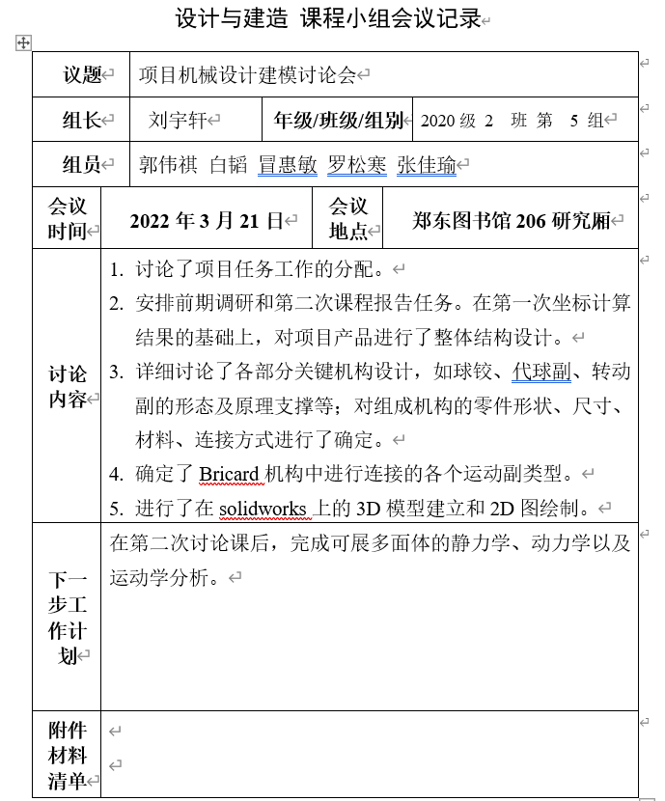
可展结构——任务分配与合作
本周期小组主要完善了可展多面体的计算，考虑零部件和标准件的材料、连接方式选择并开始可展多面体的3D建模，下面展示了各成员的任务完成情况小结。
刘宇轩：划分任务，完善计算过程和结果；Solidworks设计与建模；负责研讨课展示。
张佳瑜：Solidworks设计、转动副建模；负责模型部分的研讨课展示。
罗松寒： Solidworks设计与建模；负责需求调查产品实现部分的研讨课展；负责课程报告整理。
白韬：负责整理零件、结构设计内容整理和相关部分的研讨课展示。
郭伟祺：Solidworks设计、球副建模；负责模型部分的研讨课展示。
冒惠敏：参与结构设计；负责模型部分课程报告整理。

